Slide 2
What is SNMP?
Simple Network Management Protocol (SNMP) is an internet standard protocol used to monitor and manage network devices connected over an IP.

Slide 3
Port number
It uses port 161 and 162
Port 161 is used for polling agents.
Port 162 is used by agents to send traps.

Slide 4
SNMP basic components
SNMP Manager
Managed devices
SNMP agent
Management Information Database Otherwise called as Management Information Base (MIB)

Slide 5
SNMP Manager
A manager or management system is a separate entity that is responsible to communicate with the SNMP agent.
SNMP Manager’s key functions
Queries agents
Gets responses from agents

Slide 6
Managed Devices
A managed device or the network element is a part of the network that requires some form of monitoring and management e.g. routers, switches, servers, workstations, printers, UPSs, etc...

Slide 7
SNMP Agent
The agent is a program that is packaged within the network element. Enabling the agent allows it to collect the management information database from the device locally and makes it available to the SNMP manager, when it is queried for.

Slide 8
Management Information Base (MIB)
Every SNMP agent maintains an information database describing the managed device parameters. The SNMP manager uses this database to request the agent for specific information and further translates the information as needed for the Network Management System (NMS). This commonly shared database between the Agent and the Manager is called Management Information Base (MIB).

Slide 9
Basic SNMP Communication Diagram

Slide 10
SNMP versions
SNMPv1:
This is the first version of SNMP protocol, which is defined in RFCs 1155 and 1157
SNMPv2c:
This is the revised protocol, which includes enhancements of SNMPv1 in the areas of protocol packet types, transport mappings, MIB structure elements but using the existing SNMPv1 administration structure ("community based" and hence SNMPv2c). It is defined in RFC 1901, RFC 1905, RFC 1906, RFC 2578.
SNMPv3
SNMPv3 defines the secure version of the SNMP.

Slide 11
GET: The GET operation is a request sent by the manager to the managed device. It is performed to retrieve one or more values from the managed device.
GET BULK: The GETBULK operation is used to retrieve voluminous data from large MIB table.
TRAPS: Unlike the above commands which are initiated from the SNMP Manager, TRAPS are initiated by the Agents. It is a signal to the SNMP Manager by the Agent on the occurrence of an event.
INFORM: This command is similar to the TRAP initiated by the Agent, additionally INFORM includes confirmation from the SNMP manager on receiving the message.
RESPONSE: It is the command used to carry back the value(s) or signal of actions directed by the SNMP Manager.

Slide 13
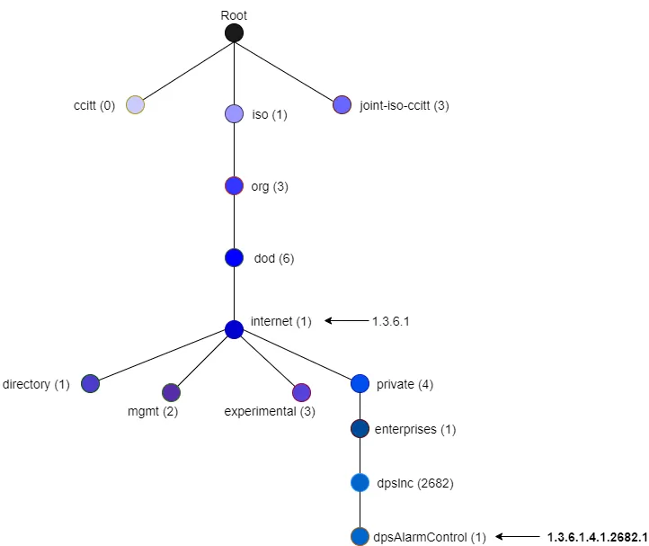

Slide 14
What is a SNMP MIB?
A MIB or Management Information Base is a formatted text file that resides within the SNMP manager designed to collect information and organize it into a hierarchical format. Resources stored within a MIB are referred to as managed objects or management variables. The simplest way to think of a MIB is as the central hub of data inside the device. The MIB contains all of the performance data that is accessed when loading up a network monitoring tool.

Slide 15
What is a SNMP OID?
Inside the MIB there are many different managed objects which can be identified by an OID or Object Identifier. An OID is an address that is used to differentiate between devices within the MIB hierarchy. The OID is used to refer to unique characteristics and navigate through variables on the connected device. The value of these identifiers varies from text to numbers and counters.

Slide 16
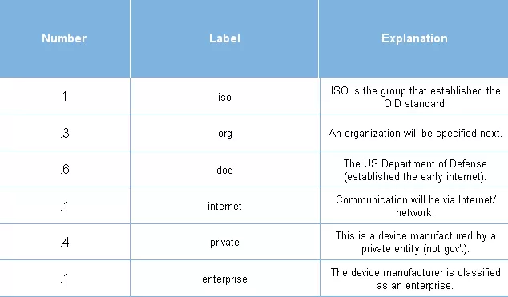

Slide 17
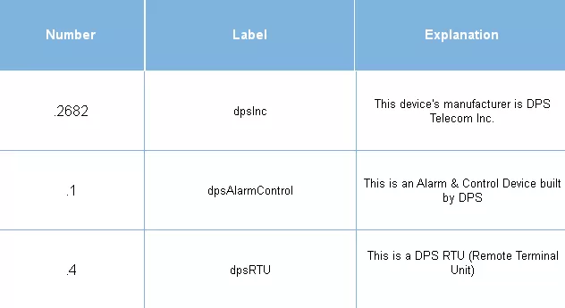

Slide 18
OID Example

Slide 19
Private Enterprise Numbers (PENs)
https://www.iana.org/assignments/enterprise-numbers/

Slide 21
Coral PEN
15939

Slide 22
Practical

